Slide 1
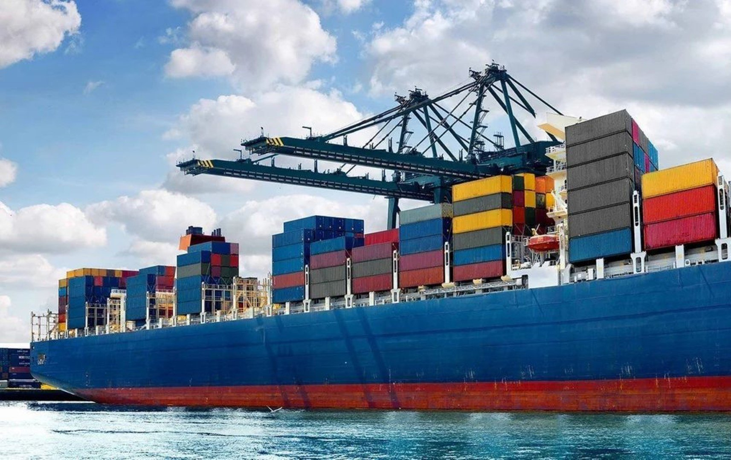
TRANSBORDER FREIGHT ANALYSIS
BUREAU OF TRANSPORTATION STATISTICS (BTS)
Compiled By: Selorm Etse-Forfoe

Slide 2
Goal
Identify inefficiencies, recognize patterns, and propose actionable solutions to improve the overall performance and sustainability of transportation systems.
2

Slide 3
Objectives
Uncover Freight Movement Patterns
Identify Operational Inefficiencies
Analyze Environmental Impact
Safety and Risk Assessment
Economic Disruptions
Provide Data-Driven Recommendations
3

Slide 4
The CRISP-DM Framework
Develop business problem and analytical questions.
Understand data and preprocess data.
Develop visualizations to communicate insights to business questions.
Provide comprehensive conclusions with actionable solutions from the analysis conducted.
4

Slide 5
Business and Analytical Questions
What are the most commonly used transport modes over time (truck, rail, air, etc.)?
How has the freight value trended across Canada and Mexico since 2020?
Which commodities contribute the most to freight value and weight?
Which ports or regions handle the most freight traffic?
How do freight trends vary across seasons or years?
Are containerized shipments more valuable than non-containerized ones?
How do freight charges vary across transport modes, and what is their impact on total trade value?
5

Slide 6
Dataset Preparation
Over 35M rows with 15 parameters
After cleaning, 28M rows with 15 parameters remaining
Rows which had null values for both Mexico State and Canada Province were considered invalid and removed, that accounts for about 20% of the data.
6

Slide 7
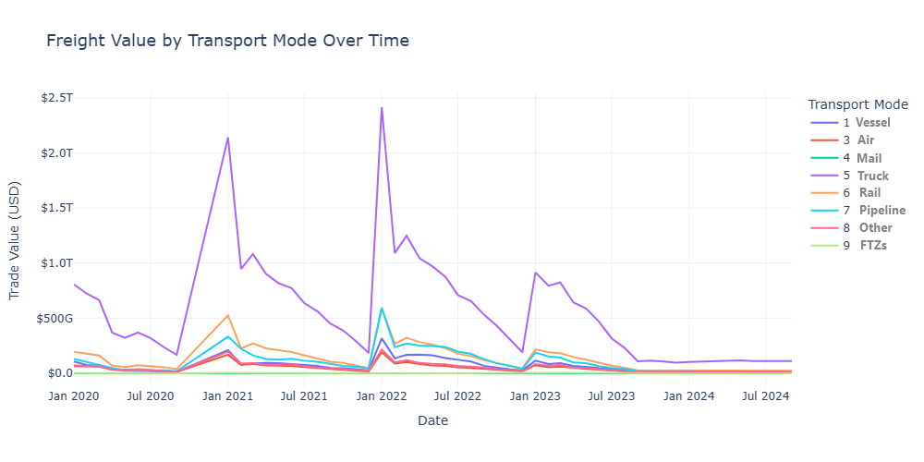
1. What are the most commonly used transport modes over time?
Truck transport leads all modes in trade value, highlighting its dominance in cross-border freight.
Rail and vessel remain steady alternatives, while air and mail contribute minimally.
Trade values consistently peak in the first quarter each year, reflecting seasonal demand cycles.
7

Slide 8
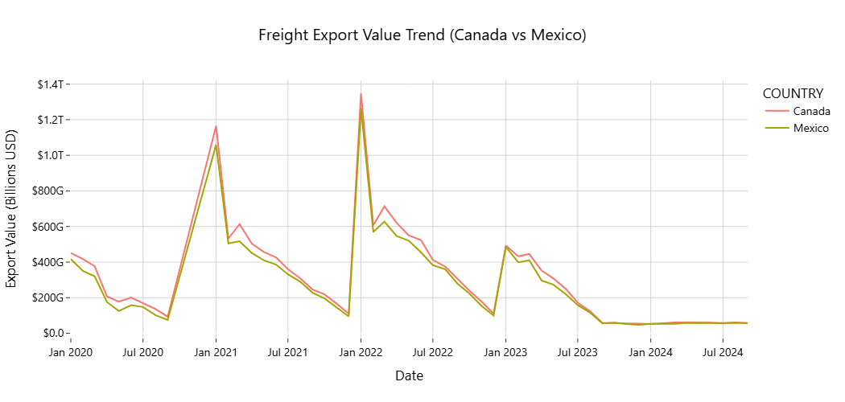
2. How has the freight value trended across Canada and Mexico since 2020?
Freight export values peaked sharply in early 2021 and 2022 – possibly driven by year-end trade surges.
Canada consistently led Mexico in export value, though both followed a similar seasonal pattern.
A gradual decline after 2022 suggests tightening global trade conditions or shifting demand trends.
8

Slide 9
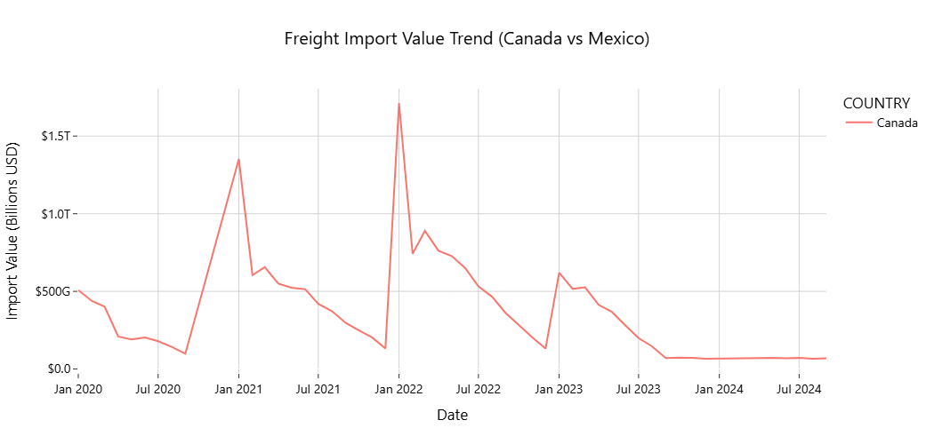
2. How has the freight value trended across Canada and Mexico since 2020?
Cont’d
Canada dominated import volumes, with noticeable spikes at the start of 2021 and 2022, likely driven by post-holiday restocking and trade normalization.
No records of imports for Mexico.
After early 2022, imports into Canada declined steadily, pointing to reduced demand, supply constraints, or policy impacts.
9

Slide 10
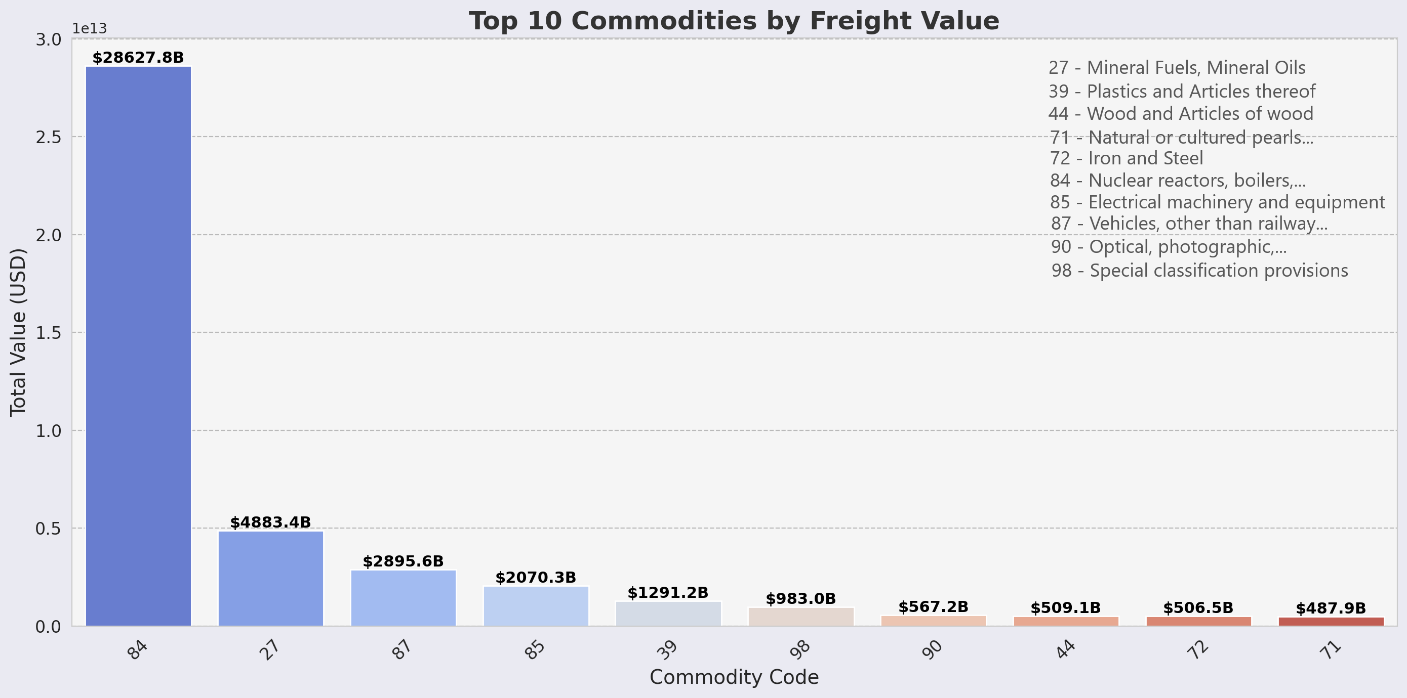
3. Which commodities contribute the most to freight value and weight?
High Value commodities happen to be high-tech, industrial, or resource-intensive.
Depicts a focus on manufacturing, energy, and advanced equipment in cross-border trade.
10

Slide 11
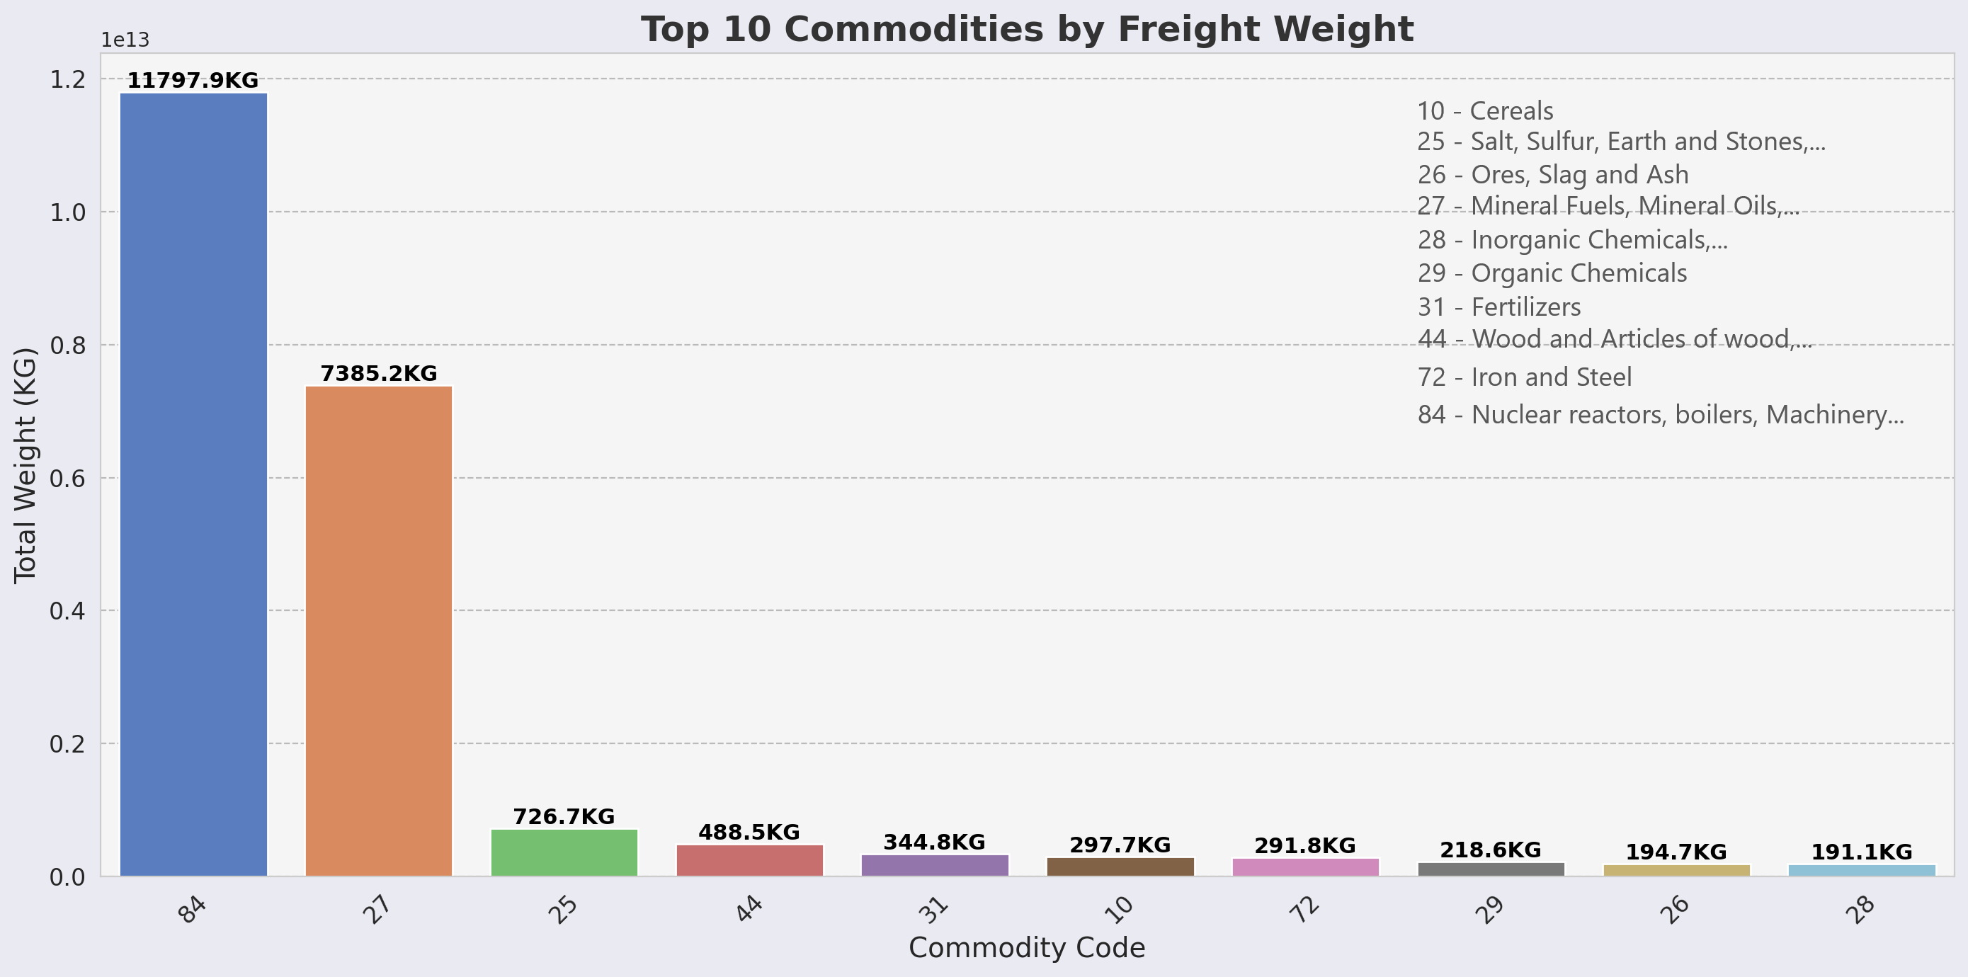
3. Which commodities contribute the most to freight value and weight?
Cont’d
High-weight commodities tend to be raw materials or bulk industrial goods, reflecting the importance of heavy industries, construction, and agriculture.
11

Slide 12
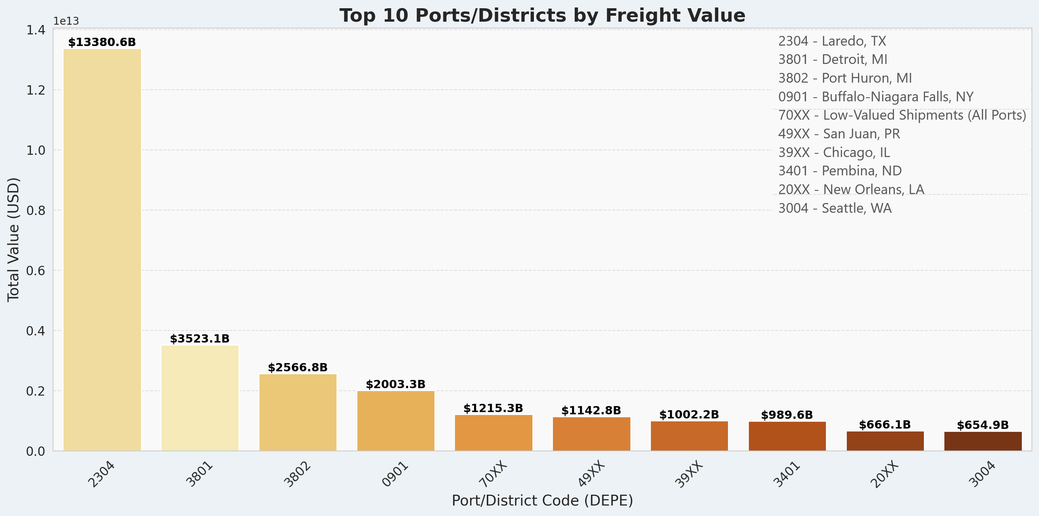
4. Which ports or regions handle the most freight traffic?
Laredo, TX (Port 2304) dominates freight value, handling $13.4T—nearly four times any other port.
Detroit and Port Huron follow, reflecting intense high-value trade along the U.S.–Canada corridor.
12

Slide 13
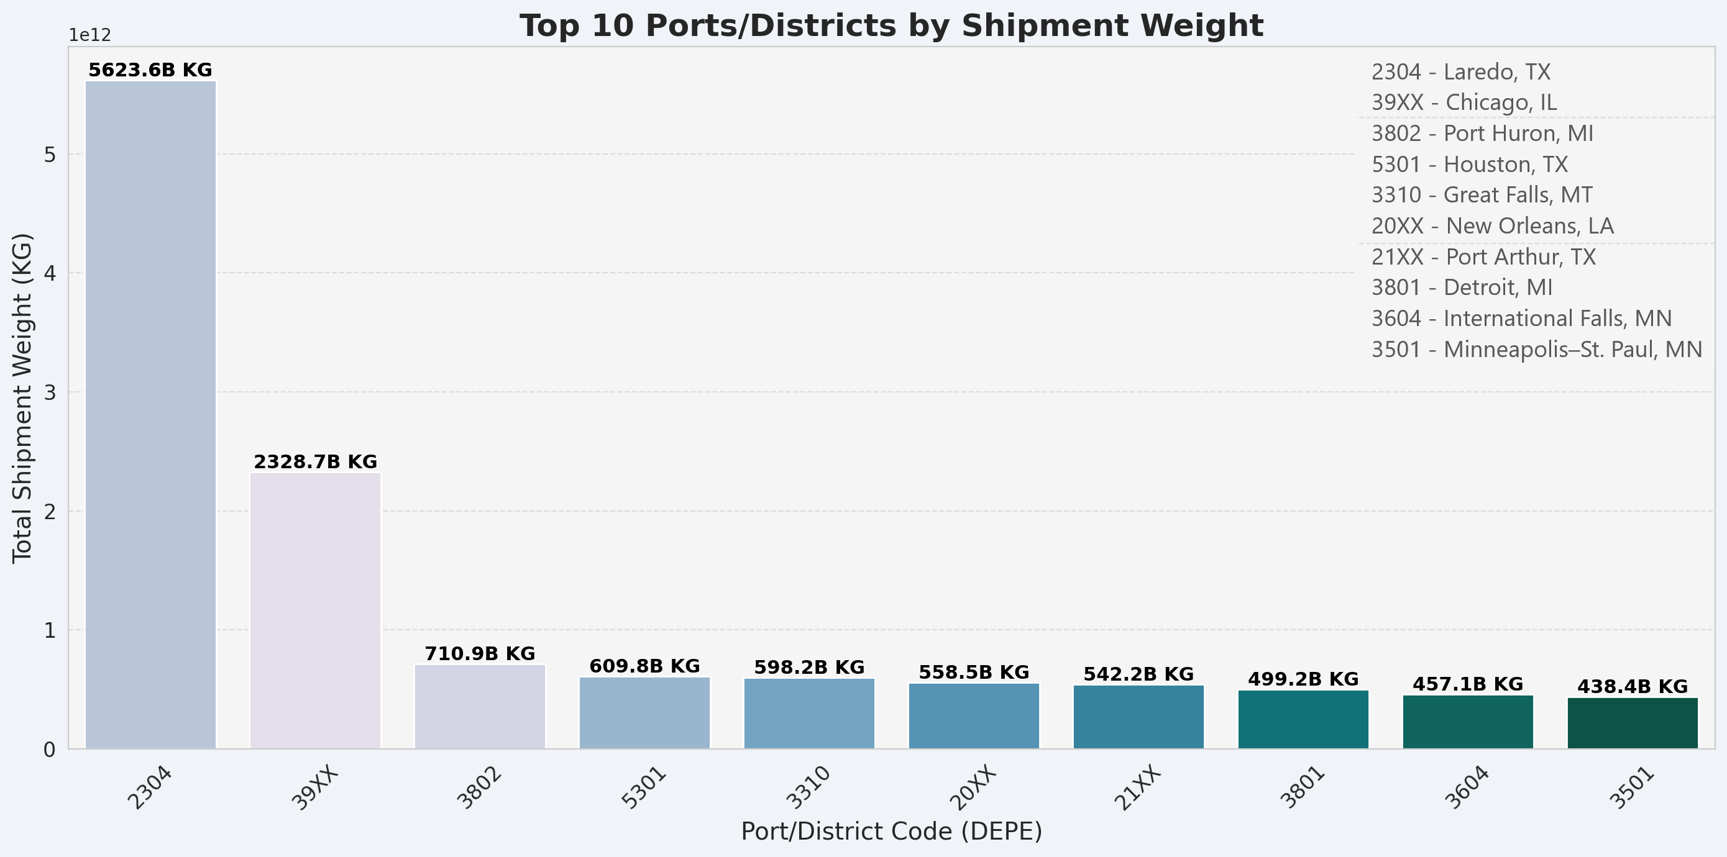
4. Which ports or regions handle the most freight traffic?
Cont’d
Laredo is the top freight hub by weight too (5.6T kg), highlighting massive trade flows with Mexico.
Chicago, Houston, and Great Falls manage heavy bulk goods, supporting inland and Gulf logistics.
13

Slide 14
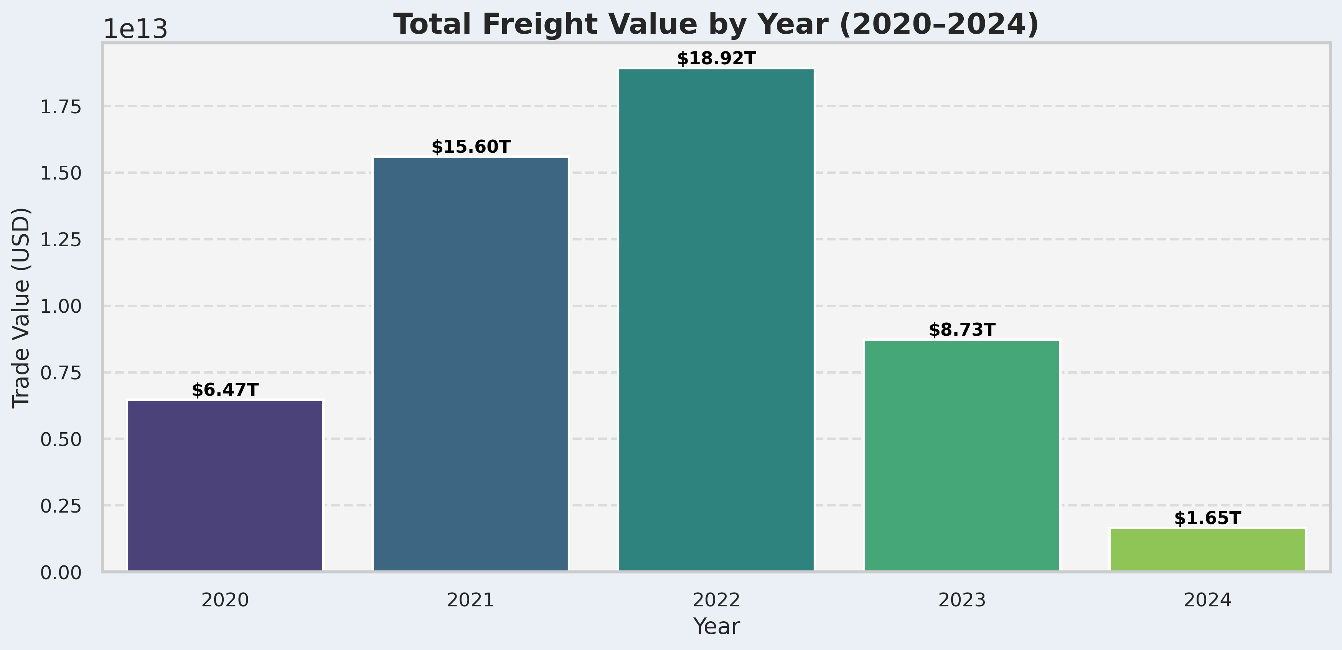
5. How do freight trends vary across seasons or years?
Freight value peaked in 2022 following a post-pandemic surge but declined steeply by 2024.
14

Slide 15
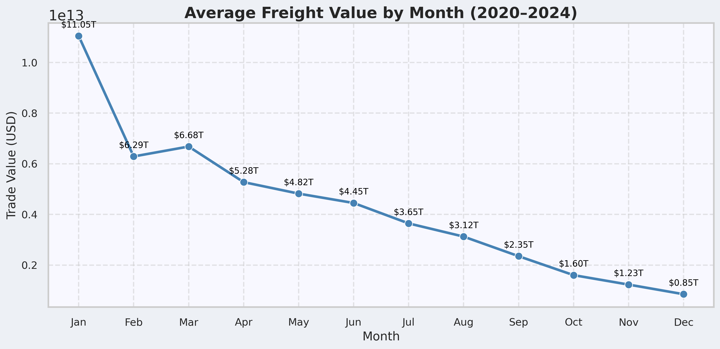
5. How do freight trends vary across seasons or years?
Cont’d
Freight activity is highest in January, tapering off toward year-end.
Quarter 1 appears to be the most commercially active.
15

Slide 16
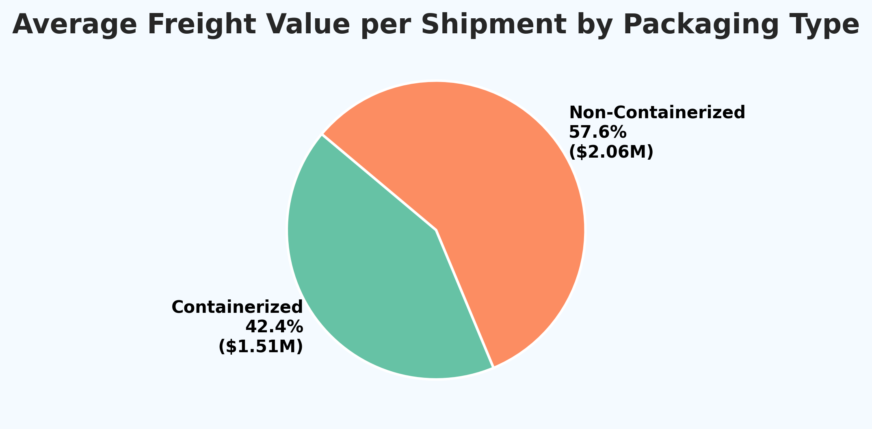
6. Are containerized shipments more valuable than non-containerized ones?
Non-containerized freight averages a higher shipment value ($2.06M) than containerized ($1.51M).
High-value cargo often moves outside containerized systems.
16

Slide 17
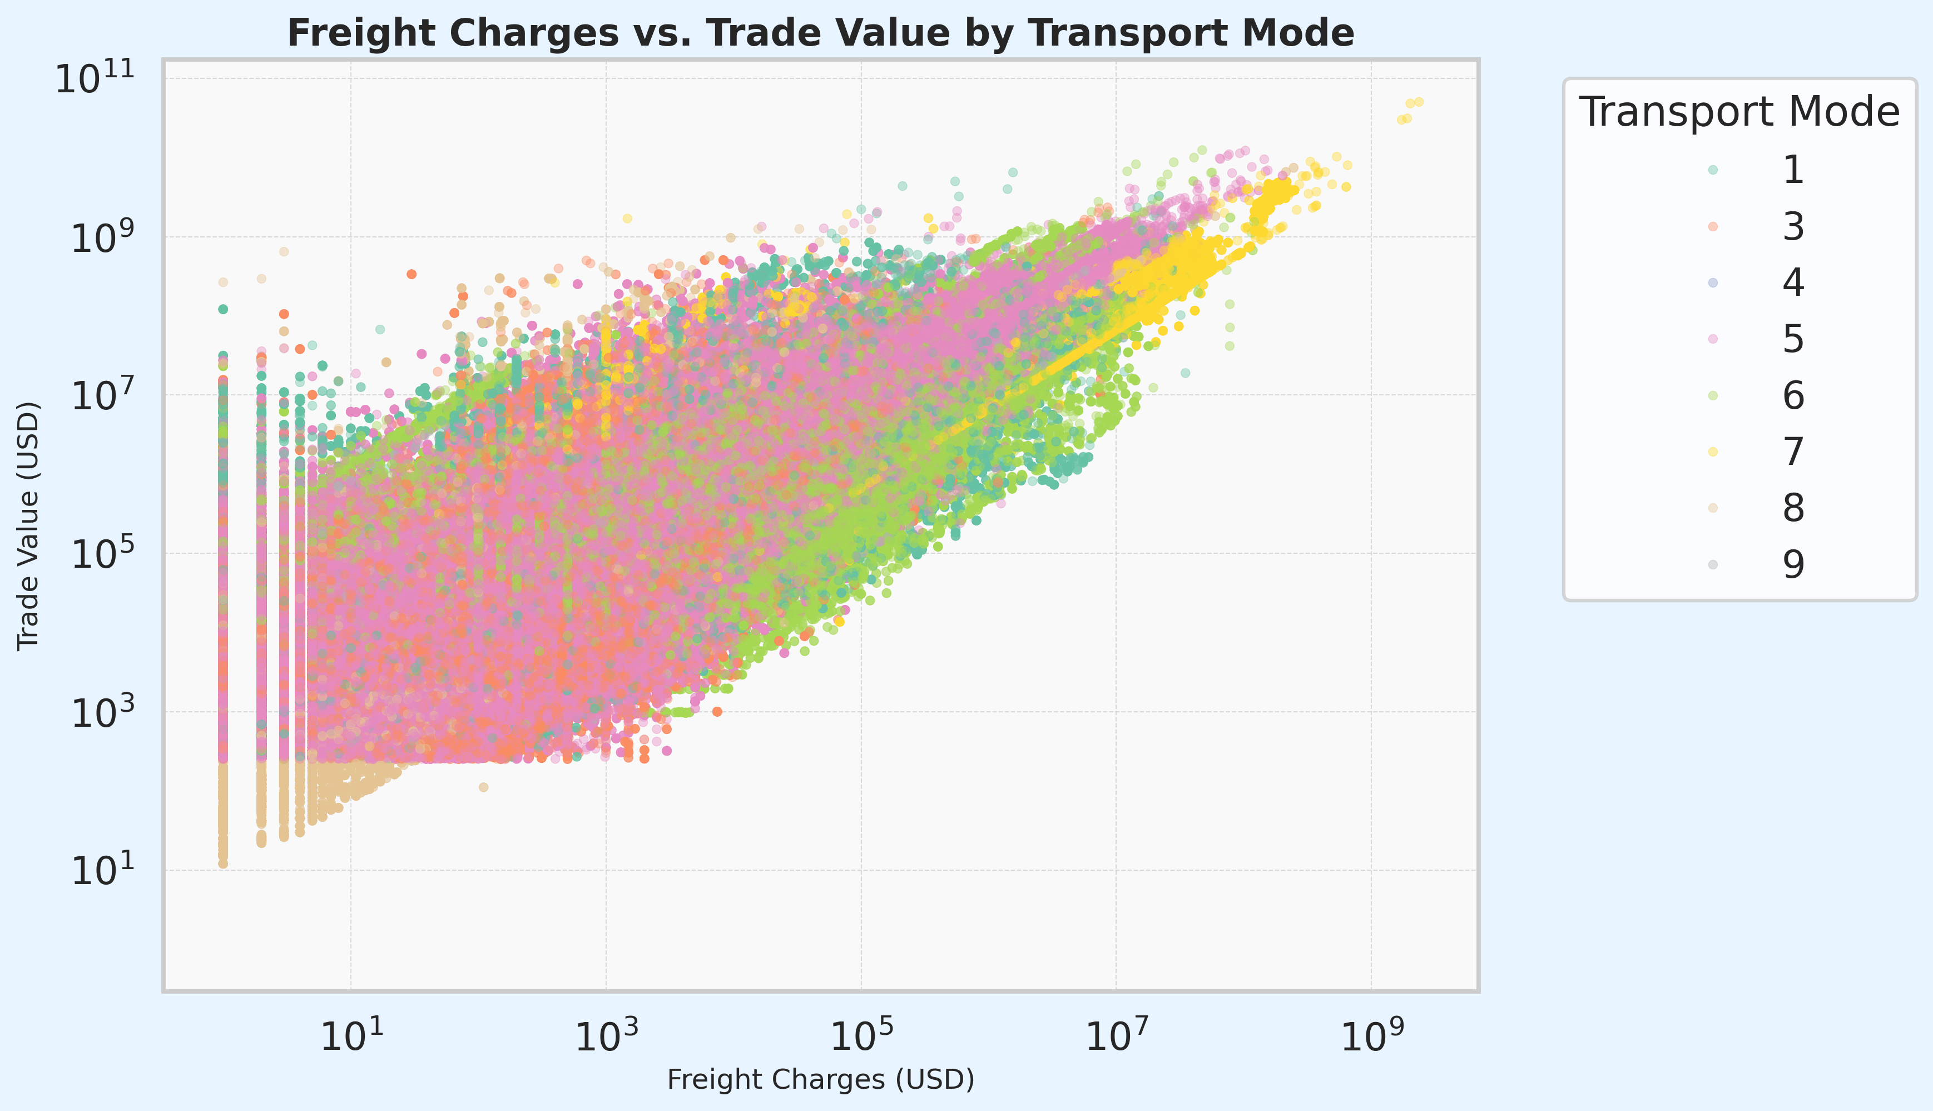
7. How do freight charges vary across transport modes, and what is their impact on total trade value?
Freight charges and trade value show a strong positive relationship across all transport modes.
17

Slide 18
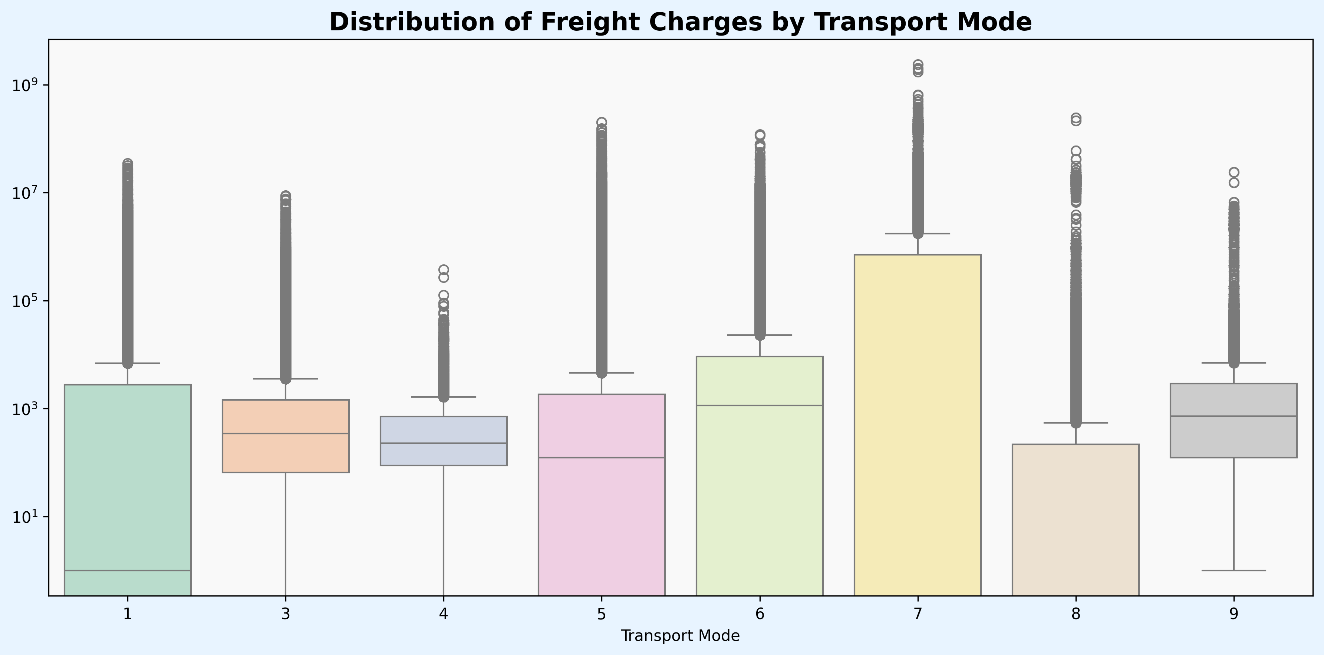
Cont’d
7. How do freight charges vary across transport modes, and what is their impact on total trade value?
Freight charges vary significantly by transport mode.
Mode 7 (Pipelines) appears to be the most expensive and volatile.
18

Slide 19
General Insights and Conclusions
Trucking dominates transborder freight activity.
Trade peaked in early 2022; steep decline followed.
Canada leads in exports; Laredo, TX, is the busiest port.
Few commodities drive most trade.
Outliers inflate averages; containerized shipments are more frequent but less valuable per unit.
19

Slide 20
General Insights and Conclusions
Fill Mexico import data gaps.
Invest in infrastructure at key ports (Laredo, Detroit, and Chicago).
Use predictive modeling for transport mode selection.
Prepare for Q1 seasonal surges.
Isolate and manage cost outliers for accurate planning.
20

